Slide 1
IO and Peripheral
General Concepts of IO and Peripheral
Digital to Analog Conversion
Analog to Digital Conversion
Handshake between devices

Slide 2
IO and Peripheral
General Concepts of IO and Peripheral
Digital to Analog Conversion
Analog to Digital Conversion
Handshake between devices

Slide 3
Basic Concept
There is an interface circuit between the
buses and IO/Peripheral
The CPU read/write data to the device
through the Data IN/OUT registers.
The status register usually is a read only register that reflects the status of the IO device.
The CPU write control words to the control word register to control the operation modes of the IO device.
Each register occupies an address.
For the PIC18 case, IO PORTs are most simple examples.
TRISA, TRISB, ..are used to control the ports for input or output
Accessing PORTA, PORTB can read/output the data to the
Peripheral.

Slide 4
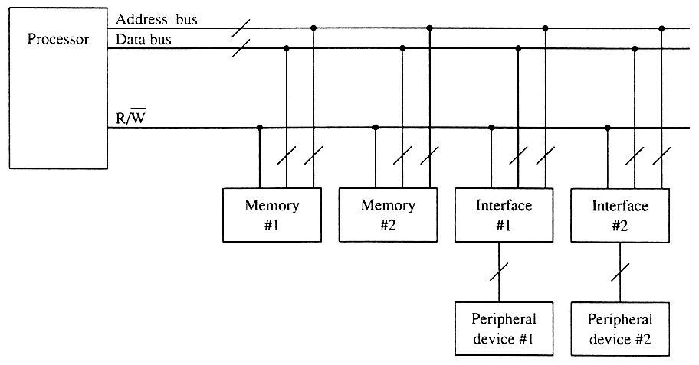
Memory Mapped I/O
IO devices are addressed and selected by decoders as if they were memory devices.
4
Notes:
4

Slide 5
Memory Mapped I/O
Advantages :
Addressed and selected like a memory device. i.e. all the memory reference operations and addressing modes can be used for I/O devices.
e.g.
MOVWF TRISC
MOVF PORTB, W
CLRF TRISB
Disadvantages :
Some system memory addresses are used up for IO and are therefore not available for memory, thus the total space for memory is reduced.
5
Notes:
5

Slide 6
Direct I/O
Using a separate address space with separate instructions and spearate control signals for I/Os
6
Notes:
6

Slide 7
Direct I/O
Advantages:
Not using the system memory address space.
Disadvantages:
Only special IN and OUT instructions can be used for I/O operations.
e.g. In 8086
IN AL, iox ; iox address, range 00-FFh
OUT iox, AL ; 8-bit io address
Note: some uPs, such as 8051, support only memory mapped I/Os and some support both. The Intel 8086 supports both.
7
Notes:
7

Slide 8
IO and Peripheral
General Concepts of IO and Peripheral
Digital to Analog Conversion
Analog to Digital Conversion
Handshake between devices

Slide 9
Data Conversion
Analog signals are continuous, with infinite values in a given range.
Examples: A clock face with hands, a voltmeter with a needle, and audio signals.
Digital signals have discrete values such as on/off or 0/1.
Examples: A digital clock or a digital voltmeter.

Slide 10
Data Conversion
Limitations of analog signals
Analog signals pick up noise as they are being amplified.
Analog signals are difficult to store.
Advantages of digital systems (signals)
Noise can be reduced by converting analog signals in 0s and 1s.
Binary signals of 0s/1s can be easily stored in memory.
The major limitation of a digital system is how accurately it represents the analog signals after conversion.

Slide 11
Embedded System
A typical system that converts signals from analog to digital and back to analog includes:
A transducer that converts non-electrical signals into electrical signals
An A/D converter that converts analog signals into digital signals
A digital processor that processes digital data
A D/A converter that converts digital signals into equivalent analog signals
A transducer that converts electrical signals into non-electrical signals

Slide 12
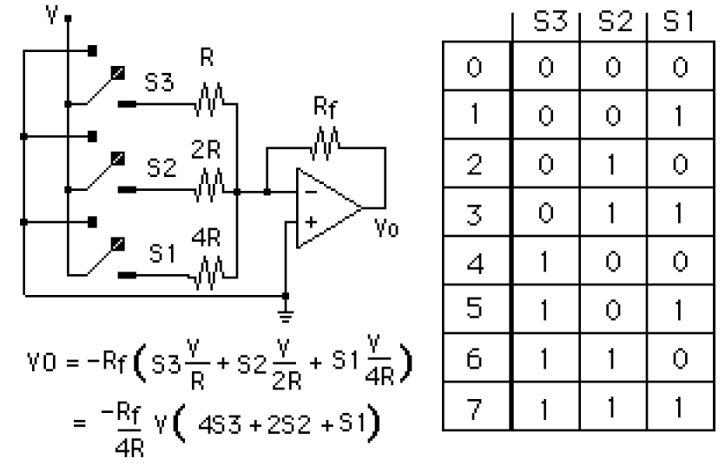
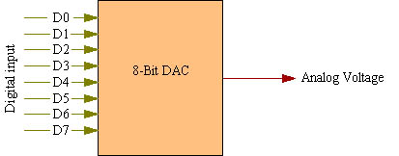
Digital to Analog
Use current source with digital switches

Slide 13
Digital to Analog Conversion
D/A, DAC, or D-to-A
Converting discrete signals into discrete analog values that represent the magnitude of the input signal compared to a standard or reference voltage
The output of the DAC is discrete analog steps.
By increasing the resolution (number of bits), the step size is reduced, and the output approximates a continuous analog signal.

Slide 14
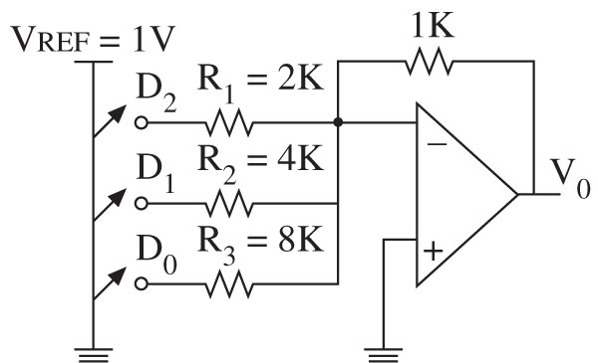
D/A Converter Circuits

Slide 15
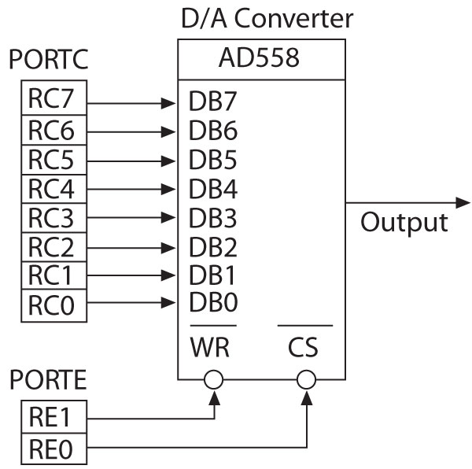
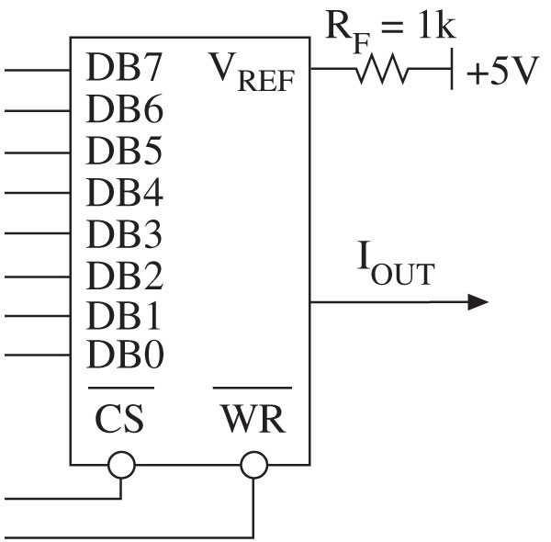

IC D/A Converters

Slide 16
IO and Peripheral
General Concepts of IO and Peripheral
Digital to Analog Conversion
Analog to Digital Conversion
Handshake between devices

Slide 17
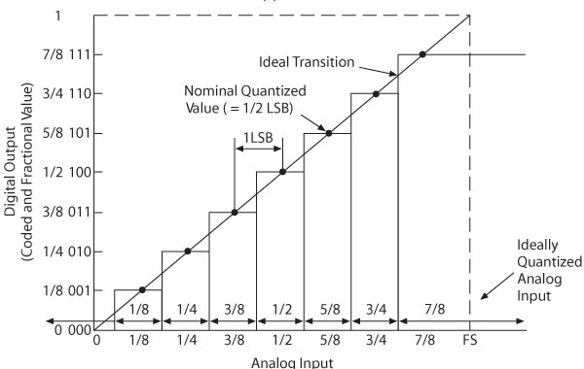
Analog-to-Digital Conversion
A/D, ADC, or A-to-D
Process of converting a continuous varying signal, such as voltage or current, into discrete digital quantities that represent the magnitude of the signal compared to standard or reference voltage

Slide 18
A/D Conversion
Flash
Uses multiple comparators in parallel
High-speed, high cost converter
Integrator
Charges a capacitor for a given amount of time using the analog signal
Slow, but high accuracy and low noise
Successive Approximation
Effective compromise among resolution, speed, and cost
Counter
Similar to successive approximation circuit
Slower, with variable conversion times

Slide 19
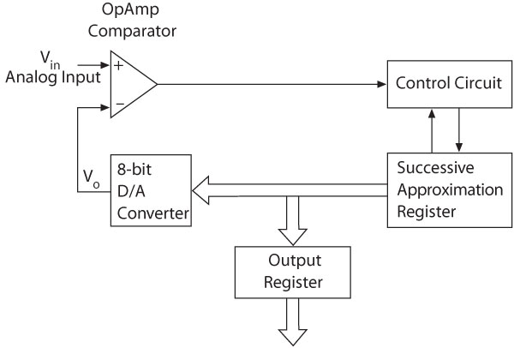
Successive Approximation

Slide 20
PIC18F A/D Converter Module
The PIC18F4520 microcontroller includes:
10-bit A/D converter
13 channels AN0 - AN12
Three control and status registers: ADCON0, ADCON1, and ADCON2
Data register: ADRESH, ADRESL

Slide 21
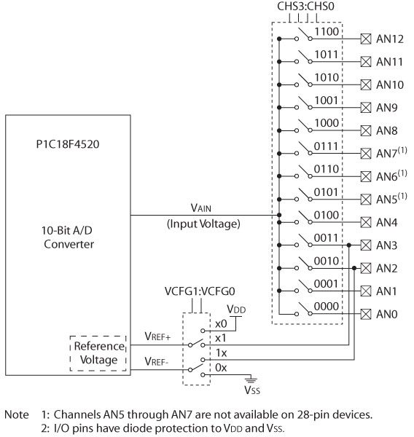
PIC18F4520 A/D Converter

Slide 22
PIC18F4520 A/D Converter
A/D converter requires a low reference voltage (VREF-) and a high reference voltage (V_{REF+}) to perform conversion. Most A/D converters are ratiomertic:
An analog input of V_{REF-} is converted to digital code 0.
An analog input of V_{REF+} is converted to digital code 2n – 1.
An analog input of V_{in} is converted to digital code
k=(2^{n} – 1) x (V_{in} - V_{REF-}) ÷ (V_{REF+} - V_{REF-})
Given k, the measured voltage is given by
V_{in}=V_{REF-} + (V_{REF+} - V_{REF-}) x k ÷ (2^{n} – 1)
Most systems use VDD and 0V as V_{REF+} and V_{REF-}, respectively.
The output of a transducer should be scaled and shifted to the range of 0V ~ VDD in order to achieve the best accuracy

Slide 23
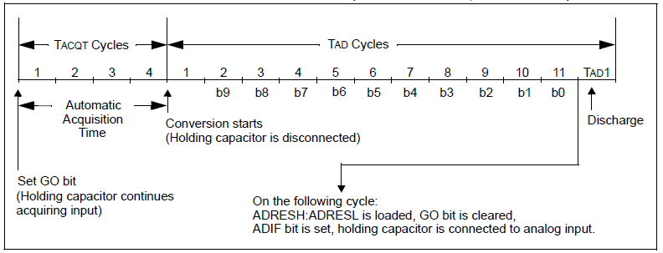
PIC18F4520 A/D Converter
T_{AD} is the conversion time per bit
T_{ACT} is the setup time for ADC.
Both timing parameters can be programed.

Slide 24
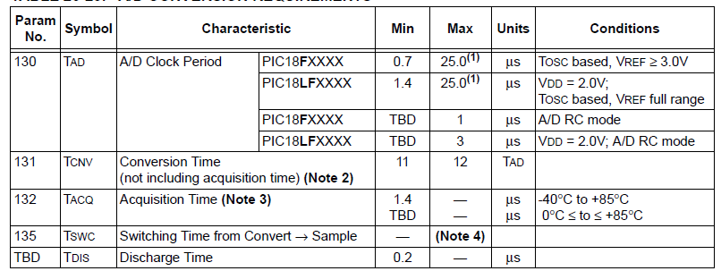
PIC18F4520 A/D Converter
T_{AD} is the conversion time per bit
T_{ACQ} is the setup time for ADC.
Both timing parameters can be programed.

Slide 25
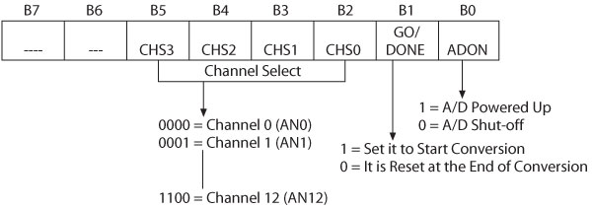
ADCON0
ADCON0 Register
Select a channel for input analog signal
Start a conversion
Indicate the end of the conversion

Slide 26
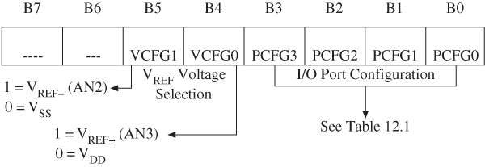
ADCON1
ADCON1 Register
Set up the I/O pins either for analog signal or for digital signals
Select V_{REF} voltages

Slide 27
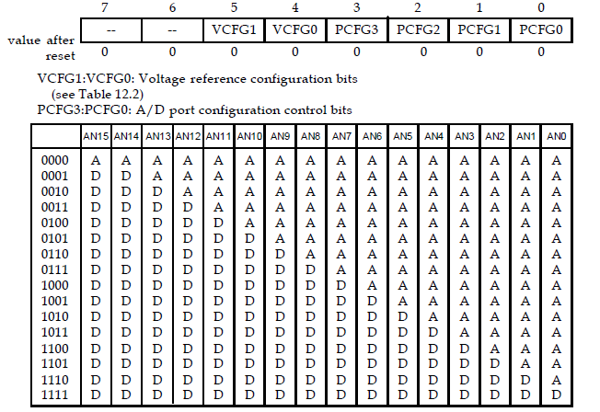
ADCON1

Slide 28
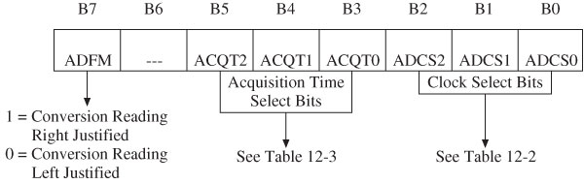
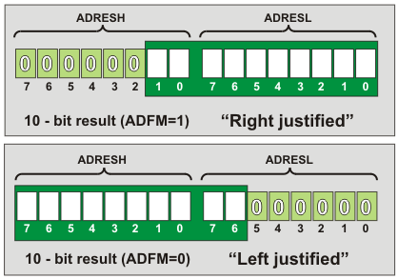
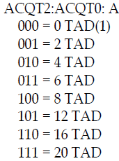
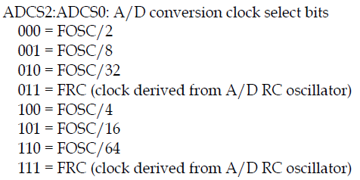
ADCON2
ADCON2 Register
Select an acquisition time and clock frequency
Right or left justify output reading

Slide 29
Selecting ADC conversion time
The programming value of T_{AD} (ADCS2-ADCS0) must be greater than the minimum value of T_{AD}
The programming value of T_{ACQ} (ACQT2-ACQT0) must be greater than the minimum of T_{ACQ}
Let
the minimum value of T_{AD} = 1.6 μs
the minimum value of T_{ACQ} = 13 μs
fosc = 32 MHz
What are (ADCS2-ADCS0) and (ACQS2-ADCS0) ?
f_{OSC} = 32 MHz, the A/D clock source must be set to 64 f_{OSC}, which makes T_{AD} =2μs. (ADCS2-ADCS0)=110.
For T_{AD} =2μs, T_{ACQ} must be set to at least 8 TAD.
(ACQT2-ACQT0)=100

Slide 30
Selecting ADC conversion time
Assembly instruction sequence that achieve the desired setting:
movlw 0x01 ; select channel AN0 and enable A/D
movwf ADCON0,A
movlw 0x0E ; configure only channel AN0 as analog port,
movwf ADCON1,A ; select VDD and VSS as reference voltage
movlw 0xA6 ; set A/D result right justified, set acquisition
movwf ADCON2,A ; time to 8 TAD, clock source FOSC/64

Slide 31
Procedure
Procedure for Performing A/D Conversion
- Configure the A/D module
1. Configure analog pins, reference voltages
2. Select A/D input channel
3. Select A/D acquisition time (if available)
4. Select A/D conversion clock
5. Enable A/D module
- Configure A/D interrupt
1. Clear ADIF flag
2. Set ADIE bit (if desired)
3. Set GIE bit (if desired)
- Wait for the desired acquisition time (if required)
- Start conversion by setting the GO/DONE bit
- Wait for A/D conversion to complete
- Read the A/D result registers; clear the ADIF flag
Notes:
In the first iteration of the loop, 7DH is added to A with CY=0 and R7=00, and the counter R2=04.
In the second iteration of the loop, EBH is added to A with CY=1. Since a carry occurred, R7 is incremented. No the counter R2=03H, R7=1, A=68H.
C5H is added to A, which makes CY=1, A=2DH, R7=02H, R2=02H.
5BH is added to A, which makes CY=0, A=88H, R7=02H, R2=01H.
30H is added to A, which makes CY=1, A=B8H, R7=02H.
DJNZ R2, AGAIN, R2=00H and not jump to AGAIN

Slide 32
Example
Example 12.6 Assume that the AN0 pin of a PIC18 running with a 32 MHz crystal oscillator is connected to a potentiometer. The voltage range of the potentiometer is from 0V to 5V. Write a program to measure the voltage applied to the AN0 pin, convert it, and retrieved the conversion result and place it in PRODH:PRODL.
Let the minimum value of T_{AD} = 1.6 μs and the minimum value of T_{ACQ} = 13 μs
Notes:
In the first iteration of the loop, 7DH is added to A with CY=0 and R7=00, and the counter R2=04.
In the second iteration of the loop, EBH is added to A with CY=1. Since a carry occurred, R7 is incremented. No the counter R2=03H, R7=1, A=68H.
C5H is added to A, which makes CY=1, A=2DH, R7=02H, R2=02H.
5BH is added to A, which makes CY=0, A=88H, R7=02H, R2=01H.
30H is added to A, which makes CY=1, A=B8H, R7=02H.
DJNZ R2, AGAIN, R2=00H and not jump to AGAIN

Slide 33
Example
org 0x00
goto start
org 0x08
retfie
org 0x18
retfie
start movlw 0x01 ; select channel AN0 and enable A/D
movwf ADCON0,A ; "
movlw 0x0E ; use VDD & VSS as reference voltages &
movwf ADCON1,A ; configure channel AN0 as analog input
movlw 0xA6 ; select FOSC/64 as conversion clock,
movwf ADCON2,A ; 8 TAD for acquisition time,
;right-justified
bsf ADCON0,GO,A ; start A/D conversion
wait_con
btfsc ADCON0,DONE,A ; wait until conversion is done
bra wait_con
movff ADRESH,PRODH ; save conversion result
movff ADRESL,PRODL ; "
end
Notes:
In the first iteration of the loop, 7DH is added to A with CY=0 and R7=00, and the counter R2=04.
In the second iteration of the loop, EBH is added to A with CY=1. Since a carry occurred, R7 is incremented. No the counter R2=03H, R7=1, A=68H.
C5H is added to A, which makes CY=1, A=2DH, R7=02H, R2=02H.
5BH is added to A, which makes CY=0, A=88H, R7=02H, R2=01H.
30H is added to A, which makes CY=1, A=B8H, R7=02H.
DJNZ R2, AGAIN, R2=00H and not jump to AGAIN

Slide 34

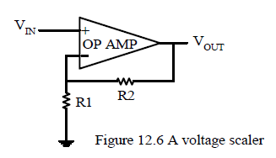
Scaling Circuit
Used to amplify the transducer output from a range of 0V ~ V_{Z} to 0 ~ V_{DD}.
- Usually V_{Z} is smaller than V_{DD}.
- Voltage gain:
Notes:
In the first iteration of the loop, 7DH is added to A with CY=0 and R7=00, and the counter R2=04.
In the second iteration of the loop, EBH is added to A with CY=1. Since a carry occurred, R7 is incremented. No the counter R2=03H, R7=1, A=68H.
C5H is added to A, which makes CY=1, A=2DH, R7=02H, R2=02H.
5BH is added to A, which makes CY=0, A=88H, R7=02H, R2=01H.
30H is added to A, which makes CY=1, A=B8H, R7=02H.
DJNZ R2, AGAIN, R2=00H and not jump to AGAIN

Slide 35
Scaling Circuit
Suppose the transducer output voltage ranges from 0V to 200 mV.
Choose the appropriate values for R1 and R2 to scale this range to 0~5V.
Solution:
R2/R1 = (V_{OUT} /V_{IN}) – 1 = 24
Choose 240 KΩ for R2 and 10 KΩ for R1.
Notes:
In the first iteration of the loop, 7DH is added to A with CY=0 and R7=00, and the counter R2=04.
In the second iteration of the loop, EBH is added to A with CY=1. Since a carry occurred, R7 is incremented. No the counter R2=03H, R7=1, A=68H.
C5H is added to A, which makes CY=1, A=2DH, R7=02H, R2=02H.
5BH is added to A, which makes CY=0, A=88H, R7=02H, R2=01H.
30H is added to A, which makes CY=1, A=B8H, R7=02H.
DJNZ R2, AGAIN, R2=00H and not jump to AGAIN

Slide 36
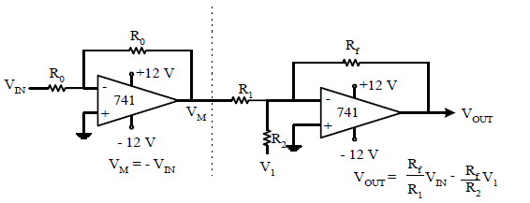
Scaling Circuit
Voltage Translation Circuit
Needed to shift and scale the transducer output in a range of –V_{X} ~ V_{Z} to 0V ~ V_{DD}
Notes:
In the first iteration of the loop, 7DH is added to A with CY=0 and R7=00, and the counter R2=04.
In the second iteration of the loop, EBH is added to A with CY=1. Since a carry occurred, R7 is incremented. No the counter R2=03H, R7=1, A=68H.
C5H is added to A, which makes CY=1, A=2DH, R7=02H, R2=02H.
5BH is added to A, which makes CY=0, A=88H, R7=02H, R2=01H.
30H is added to A, which makes CY=1, A=B8H, R7=02H.
DJNZ R2, AGAIN, R2=00H and not jump to AGAIN

Slide 37
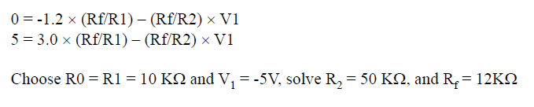
Scaling Circuit
Choose appropriate resistor values and the adjusting voltage so that the circuit shown in the last page can shift the voltage from the range of –1.2V ~ 3.0V to the range of 0V ~ 5V.
Solution:
Notes:
In the first iteration of the loop, 7DH is added to A with CY=0 and R7=00, and the counter R2=04.
In the second iteration of the loop, EBH is added to A with CY=1. Since a carry occurred, R7 is incremented. No the counter R2=03H, R7=1, A=68H.
C5H is added to A, which makes CY=1, A=2DH, R7=02H, R2=02H.
5BH is added to A, which makes CY=0, A=88H, R7=02H, R2=01H.
30H is added to A, which makes CY=1, A=B8H, R7=02H.
DJNZ R2, AGAIN, R2=00H and not jump to AGAIN

Slide 38
IO and Peripheral
General Concepts of IO and Peripheral
Digital to Analog Conversion
Analog to Digital Conversion
Handshake between devices

Slide 39
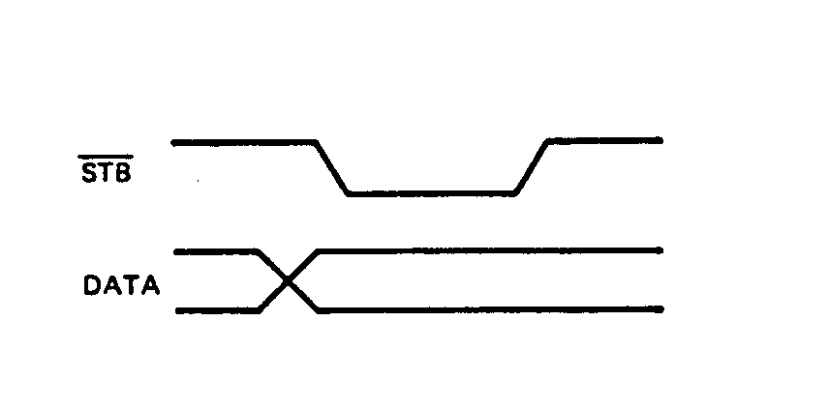
Simple Strobe I/O
The sender outputs a strobe signal, STB, to indicate the data is ready.
Works well for low rates data transfer but fails at higher rate due to no acknowledge of the received signal.
39
Notes:
39

Slide 40
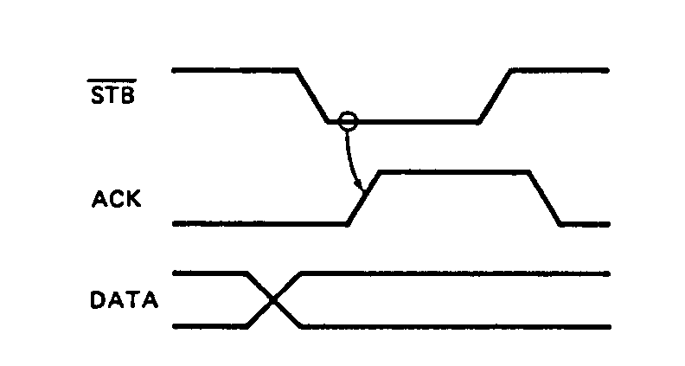
Single Handshake I/O
The sender outputs the data and sends an STB signal to the receiver. After taking the data, the receiver sends an ACK signal, to acknowledge the receive of the data.
40
Notes:
40

Slide 41
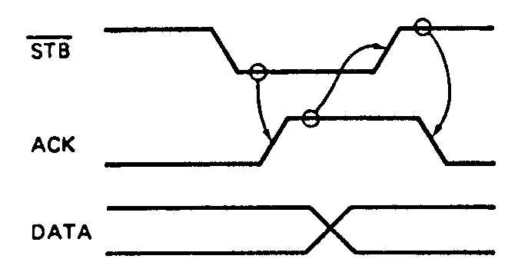
Double Handshake I/O
(1) The sender asserts its STB line low to ask the receiver if it is ready. (2) The receivers, if ready, will respond by sending the ACK signal. (3) The sender then sends the data and raises its STB line high. (4) After taking the data, the receiver acknowledges it by letting ACK low.
41
Notes:
41

